Slide 1
2. Database System-Concepts and Architecture (3 Hrs)
Data Models, Schemas, and Instance; Three Schema Architecture and Data Independence;
Database Languages and Interfaces;
The Database System Environment; Centralized and Client/Sever Architecture for DBMSs;
Classification of Database Management Systems

Slide 2
Data Models
Data Model:
  A set of concepts to describe the structure of a database, the operations for manipulating these structures, and certain constraints that the database should obey.
Data Model Structure and Constraints:
  Constructs are used to define the database structure
  Constructs typically include elements (and their data types) as well as groups of elements (e.g. entity, record, table), and relationships among such groups
  Constraints specify some restrictions on valid data; these constraints must be enforced at all times

Slide 3
Data Models (continued)
Data Model Operations:
  These operations are used for specifying database retrievals and updates by referring to the constructs of the data model.
  Operations on the data model may include basic model operations (e.g. generic insert, delete, update) and user-defined operations (e.g. compute_student_gpa, update_inventory)

Slide 4
Categories of Data Models
Conceptual (high-level, semantic) data models:
  Provide concepts that are close to the way many users perceive data.
    (Also called entity-based or object-based data models.)
Physical (low-level, internal) data models:
  Provide concepts that describe details of how data is stored in the computer.
  These are usually specified in an ad-hoc manner through DBMS design and administration manuals
Implementation (representational) data models:
  Provide concepts that fall between the above two, used by many commercial DBMS implementations (e.g. relational data models used in many commercial systems).

Slide 5
Data Models
The basic structure or design of the database is the data model. A data model is a collection of conceptual tools for describing data, data relationships, data semantics, and consistency constraints.
Some data models are given below:
Entity-Relationship Model:
  Entity-relationship (E-R) model is a high level data model based on a perception of a real world that consists of collection of basic objects, called entities, and of relationships among these entities.
  An entity is a thing or object in the real world that is distinguishable from other objects.
  Entities are described in a database by a set of attributes.
  A relationship is an association among several entities.
  The set of all entities of the same type is called an entity set and the set of all relationships of the same type is called a relationship set.
1-<number>

Slide 6

Entity-Relationship Model
  Overall logical structure of a database can be expressed graphically by E-R diagram. The basic components of this diagram are:
    Rectangles (represent entity sets)
    Ellipses (represent attributes)
    Diamonds (represent relationship sets among entity sets)
    Lines (link attributes to entity sets and entity sets to relationship sets)
  The figure below shows an example of E-R diagram.

Slide 7
Relational Model
Relational Model:
  It is the current favorite model. The relational model is a lower level model that uses a collection of tables to represent both data and relationships among those data.
  Each table has multiple columns, and each column has a unique name. Each table corresponds to an entity set or relationship set, and each row represents an instance of that entity set or relationship set.
  Relationships link rows from two tables by embedding row identifiers (keys) from one table as attribute values in the other table.
  Structured query language (SQL) is used to manipulate data stored in tables.

Slide 8

  Fig: A sample relational database

Slide 9
Relational Model
The relational data model is the most widely used data model, and a vast majority of current database systems are based on the relational model.
The relational model is at a lower level of abstraction than the E-R model.
Database designs are often carried out in the E-R model, and then translated to the relational model.

Slide 10
Hierarchical Model
This model assumes that a tree structure is the most frequently occurring relationship.
It hierarchical data model is the oldest type of data model. It is the record based representation data model.
In this model, different records are interrelated through hierarchical structure.
The root may have any number of dependents, each of these dependents may have any number of lower level dependents.

Slide 11
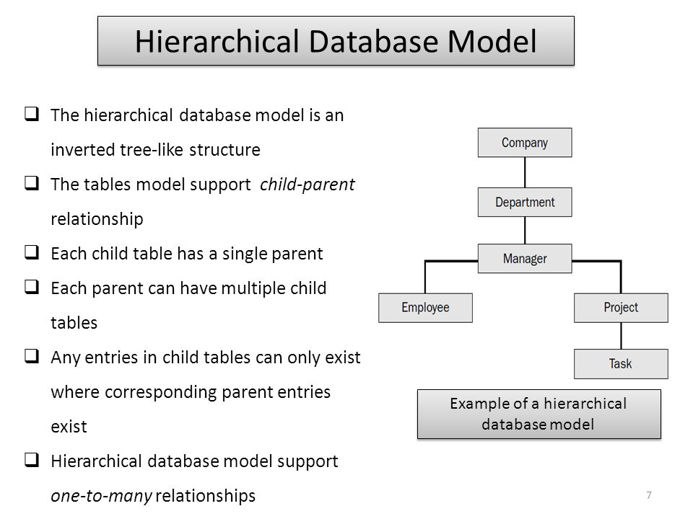

Slide 12
Network Model
A network model is an extension of the hierarchical database structure. It is more flexible than hierarchical data model
The network model replaces the hierarchical tree with a graph thus allowing more general connections among the nodes.
This model was evolved to specially handle non-hierarchical relationships.

Slide 13
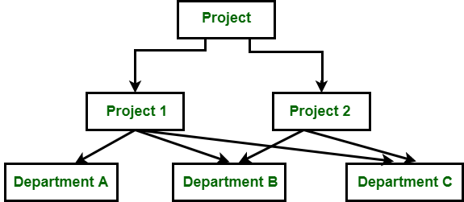
Network Model
Figure: Network Model

Slide 14
Object-oriented Data Model
This model represents an entity set as a class. A class represents both object attributes as well as the behavior of the entity.
Instances of class are objects. Within an object, the class attributes take specific values. However the behavior patterns of the class is shared by all the objects belonging to the class.
Attribute values can be primitive data types usually associated with databases and programming languages or other objects. The object-oriented model maintains relationships through ‘logical-containment’.

Slide 15
Object-oriented Data Model
Object Oriented Data Model: The object oriented data model is based on object oriented programming paradigm.
A core object oriented data model consists of the following basic object oriented concepts:
Object: Any real world entity is uniformly modeled as an object
Attributes and method: Every object has a state (set of values for the attributes of the object) and a behavior (the set of methods-program code-which operate on the state of the object). The state and behavior encapsulated in single place using class.

Slide 16
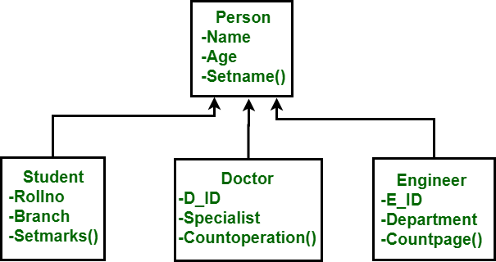
Object-oriented Data Model
Class: a means of grouping all the objects which share the same set of attributes and methods. An object must belong to only one class. A class is similar is an abstract data type
Figure: Object Oriented Data Model

Slide 17
Instances and Schemas
The description of a database is called the database schema, which is specified during database design and is not expected to change frequently.
DB Schema
  captures data types, relationships, constraints on the data
  is independent of any application program
Databases change over time as data is inserted and deleted. The collection of data stored in the database at a particular moment of time is called an instance of the database. Also known as DB State.
1-<number>

Slide 18
Schemas versus Instances
Database Schema:
  The description of a database.
  Includes descriptions of the database structure, data types, and the constraints on the database.
Schema Diagram:
  An illustrative display of (most aspects of) a database schema.
Schema Construct:
  A component of the schema or an object within the schema, e.g., STUDENT, COURSE.
1-<number>

Slide 19
Schemas versus Instances…
Database State:
  The actual data stored in a database at a particular moment in time. This includes the collection of all the data in the database.
  Also called database instance (or occurrence or snapshot).
    The term instance is also applied to individual database components, e.g. record instance, table instance, entity instance
1-<number>

Slide 20
Database Schema vs. Database State
Database State:
  Refers to the content of a database at a moment in time.
Initial Database State:
  Refers to the database state when it is initially loaded into the system.
Valid State:
  A state that satisfies the structure and constraints of the database.

Slide 21
Database Schema vs. Database State (continued)
Distinction
  The database schema changes very infrequently.
  The database state changes every time the database is updated.
Schema is also called intension.
State is also called extension.

Slide 22

Example of a Database Schema

Slide 23

Example of a database state

Slide 24
Three-Schema Architecture
Proposed to support DBMS characteristics of:
  Program-data independence.
  Support of multiple views of the data.
Not explicitly used in commercial DBMS products, but has been useful in explaining database system organization

Slide 25
Three-Schema Architecture
Defines DBMS schemas at three levels:
  Internal schema at the internal level to describe physical storage structures and access paths (e.g indexes).
    Typically uses a physical data model.
  Conceptual schema at the conceptual level to describe the structure and constraints for the whole database for a community of users.
    Uses a conceptual or an implementation data model.
  External schemas at the external level to describe the various user views.
    Usually uses the same data model as the conceptual schema.

Slide 26

The three-schema architecture

Slide 27
Three-Schema Architecture
Mappings among schema levels are needed to transform requests and data.
  Programs refer to an external schema and are mapped by the DBMS to the internal schema for execution.
  Data extracted from the internal DBMS level is reformatted to match the user’s external view (e.g. formatting the results of an SQL query for display in a Web page)

Slide 28
Data Abstraction
Data abstraction is the process providing easy interface to users by hiding all underlying complexities of data management from users.
Database System provides users with an abstract view of the data.
Data abstraction is provided in database management system by using three level schema (ANSI/SPARC)

Slide 29
Data Independence
Logical Data Independence:
  The capacity to change the conceptual schema without having to change the external schemas and their associated application programs.
Physical Data Independence:
  The capacity to change the internal schema without having to change the conceptual schema.
  For example, the internal schema may be changed when certain file structures are reorganized, or new indexes are created to improve database performance

Slide 30
Data Independence (continued)
When a schema at a lower level is changed, only the mappings between this schema and higher-level schemas need to be changed in a DBMS that fully supports data independence.
The higher-level schemas themselves are unchanged.
  Hence, the application programs need not be changed since they refer to the external schemas.

Slide 31
DBMS Architecture
The DBMS architecture proposed by ANSI/SPARC (American National Standards Institute, Standards Planning And Requirements Committee) (ANSI/SPARC architecture) is defined at three levels. This architecture is also called three-schema architecture.
This architecture provides three levels of abstraction to simplify users’ interaction with the system.
It provides users with an abstract view of data. The system hides certain details of how data are stored and maintained.
The goal of this architecture is to separate the user applications from physical database.
It divides the system into three levels of abstraction: the internal or physical level, the logical or conceptual level, and the external or view level.

Slide 32
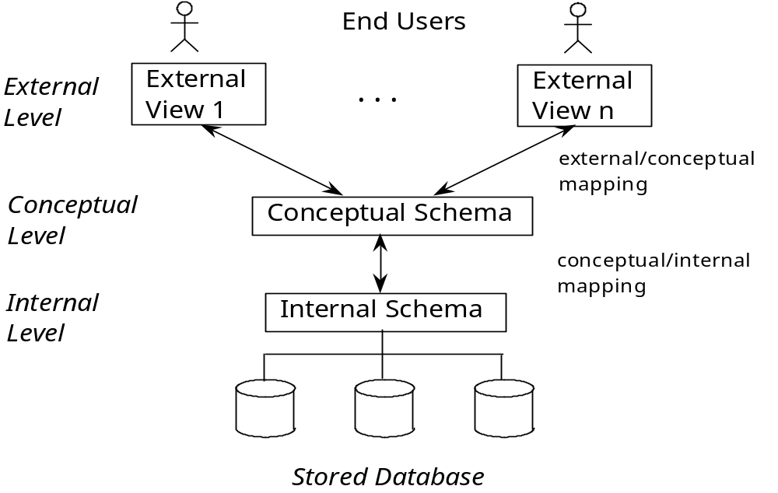
DBMS Architecture
1-<number>

Slide 33
DBMS Architecture
Physical Level or Internal Level:
  It is the lowest level of abstraction and describes how the data in the database are actually stored.
  This level describes complex low-level data structures in detail and is concerned with the way the data is physically stored.
  Data only exists at physical level.
Logical Level or Conceptual Level:
  This is the next higher level of abstraction and describes what data are stored in the database, and what relationships exist among those data.
  It describes the structure of whole database and hides details of physical storage structure.
  It concentrates on describing entities, data types, relationships, attributes and constraints.
  All of the views must be derivable from this conceptual schema.

Slide 34
DBMS Architecture
View Level or External Level:
  It is the highest level of abstraction and is concerned with the way the data is seen by individual users.
  This level simplifies the users’ interaction with the system.
  It includes a number of user views and hence is guided by the end user requirement.
  It describes only those part of the database in which the users are interested and hides rest of all from those users. Each user group refers to its own external schema.
The DBMS must transform a request specified on an external schema into a request against the conceptual schema, and then into a request on the internal schema for processing over the database. The process of transforming requests and results between levels is called mapping.

Slide 35
DBMS Languages
Data Definition Language (DDL)
Data Manipulation Language (DML)
  High-Level or Non-procedural Languages: These include the relational language SQL
    May be used in a standalone way or may be embedded in a programming language
  Low Level or Procedural Languages:
    These must be embedded in a programming language

Slide 36
DBMS Languages
Data Definition Language (DDL):
  Used by the DBA and database designers to specify the conceptual schema of a database.
  In many DBMSs, the DDL is also used to define internal and external schemas (views).
  In some DBMSs, separate storage definition language (SDL) and view definition language (VDL) are used to define internal and external schemas.
    SDL is typically realized via DBMS commands provided to the DBA and database designers
DDL Commands
  Create Statement
  Drop Statement
  Alter Statement

Slide 37
Create Statement
CREATE TABLE account
(
account_number CHAR(10),
balance INTEGER,
branch CHAR(10)
)

Slide 38
DROP STATEMENT
DROP TABLE Table_name
DROP TABLE account

Slide 39
ALTER TABLE
Allows us to modify a given table
  ALTER TABLE Table_name modify balance number(8,2);
Removing a existing column:
  DROP column (column_name)
Adding new Column
  ALTER TABLE Table_name ADD (column name datatype)
Adding constraints
  ALTER TABLE Table_name add constraints PK_Tb1 primary key(id);
Rename table
  ALTER TABLE Tb1 rename to tb2;

Slide 40
DBMS Languages
Data Manipulation Language (DML):
  Used to specify database retrievals and updates
  DML commands (data sublanguage) can be embedded in a general-purpose programming language (host language), such as COBOL, C, C++, or Java.
    A library of functions can also be provided to access the DBMS from a programming language
  Alternatively, stand-alone DML commands can be applied directly (called a query language).

Slide 41
Types of DML
High Level or Non-procedural Language:
  For example, the SQL relational language
  Are “set”-oriented and specify what data to retrieve rather than how to retrieve it.
  Also called declarative languages.
Low Level or Procedural Language:
  Retrieve data one record-at-a-time;
  Constructs such as looping are needed to retrieve multiple records, along with positioning pointers.

Slide 42
Data Manipulation Language
Data Language that enables insert, delete, update and retrieve data from database is called data manipulation language (DML). Query language is only a part of data manipulation language.
DML statements are converted into equivalent low level statements by DML compiler.
SQL supports following DML statements
Insert Statement
Delete Statement
Update Statement
Select Statement

Slide 43
Data Manipulation Language
Insert Statement: The insert statement is used to insert a record into a table.
insert into table_name values (value1, value2,….)

Slide 44
Data Manipulation Language
Delete Statement: It is used to delete rows from table.
  DELETE FROM table_name
  WHERE (condition)

Slide 45
The SQL SELECT Statement
The SELECT statement is used to select data from a database.
The data returned is stored in a result table, called the result-set.
SELECT Syntax
SELECT column1, column2, ...
FROM table_name;

Slide 46
The SQL SELECT Statement…
Here, column1, column2, ... are the field names of the table you want to select data from.
If you want to select all the fields available in the table, use the following syntax:
SELECT * FROM table_name;

Slide 47
The SQL SELECT Statement
The SELECT statement is used to select data from a database.
The data returned is stored in a result table, called the result-set.
SELECT Syntax
SELECT column1, column2, ...
FROM table_name;

Slide 48
The SQL SELECT Statement…
Here, column1, column2, ... are the field names of the table you want to select data from.
If you want to select all the fields available in the table, use the following syntax:
SELECT * FROM table_name;

Slide 49
SQL UPDATE Statement
SQL UPDATE: SQL UPDATE is used to change the data of the records held by tables. Which rows to be updated, it is decided by a condition. To specify condition, we use WHERE clause.
UPDATE table_name [set column_name1=value1,….]
WHERE <condition>

Slide 50
DBMS Interfaces
Stand-alone query language interfaces
  Example: Entering SQL queries at the DBMS interactive SQL interface (e.g. SQL*Plus in ORACLE)
Programmer interfaces for embedding DML in programming languages
User-friendly interfaces
  Menu-based, forms-based, graphics-based, etc.

Slide 51
DBMS Programming Language Interfaces
Programmer interfaces for embedding DML in a programming languages:
  Embedded Approach: e.g embedded SQL (for C, C++, etc.), SQLJ (for Java)
  Procedure Call Approach: e.g. JDBC for Java, ODBC for other programming languages
  Database Programming Language Approach: e.g. ORACLE has PL/SQL, a programming language based on SQL; language incorporates SQL and its data types as integral components

Slide 52
User-Friendly DBMS Interfaces
  Menu-based, popular for browsing on the web
  Forms-based, designed for naïve users
  Graphics-based
    (Point and Click, Drag and Drop, etc.)
  Natural language: requests in written English
  Combinations of the above:
    For example, both menus and forms used extensively in Web database interfaces

Slide 53
Other DBMS Interfaces
  Speech as Input and Output
  Web Browser as an interface
  Parametric interfaces, e.g., bank tellers using function keys.
  Interfaces for the DBA:
    Creating user accounts, granting authorizations
    Setting system parameters
    Changing schemas or access paths

Slide 54
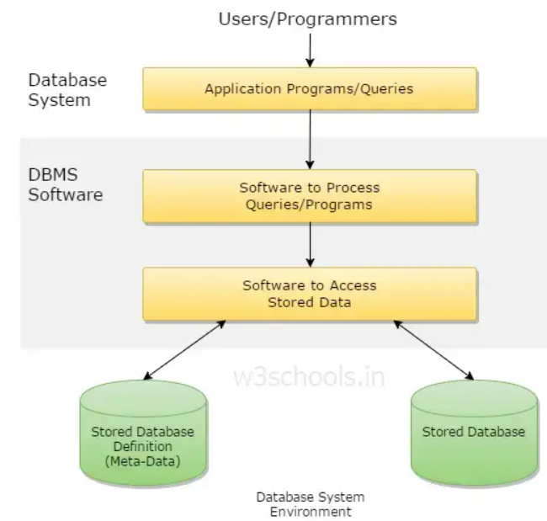
The Database System Environment
A database environment is a collective system of components that comprise and regulates the group of data, management, and use of data, which consist of software, hardware, people, techniques of handling database, and the data also.
A database environment consists of software components that constitute a DBMS and the types of computer system software with which the DBMS interacts.
1-<number>

Slide 55

Typical DBMS Component Modules

Slide 56
Database System Utilities
Database utilities help the DBA manage the database system.
Common utilities to perform certain functions:
  Loading data stored in files into a database. Includes data conversion tools.
  Backing up the database periodically on tape.
  Reorganizing database file structures.
  Report generation utilities.
  Performance monitoring utilities.
  Other functions, such as sorting, user monitoring, data compression, etc.

Slide 57
Centralized and
Client-Server DBMS Architectures
Centralized DBMS:
  Combines everything into single system including- DBMS software, hardware, application programs, and user interface processing software.
  User can still connect through a remote terminal – however, all processing is done at centralized site.

Slide 58

A Physical Centralized Architecture

Slide 59
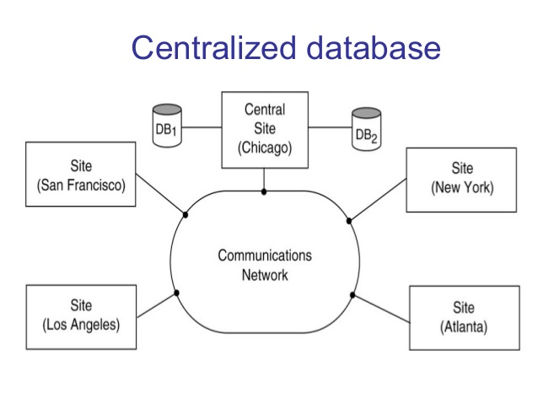

Slide 60
Client/server architecture
Client –Server Database Systems : In client/server architecture, the processing power of the computer at the user’s end is utilized by processing the user-interface on that system.
A client is a computer system that sends requests to the server connected to the network and a sever is a computer system that receives the request, processes it and returns the requested information back to the client.
Client and server are usually present at different sites. The end users work on the client computer system and database system runs on the server.
There are two approaches to implement client/server architecture:
  two-trier architecture and
  three-tier architecture.

Slide 61
Basic 2-tier Client-Server Architectures
Specialized Servers with Specialized functions
  Print server
  File server
  DBMS server
  Web server
  Email server
Clients can access the specialized servers as needed

Slide 62

Logical two-tier client server architecture

Slide 63
Clients
Provide appropriate interfaces through a client software module to access and utilize the various server resources.
Clients may be diskless machines or PCs or Workstations with disks with only the client software installed.
Connected to the servers via some form of a network.
  (LAN: local area network, wireless network, etc.)

Slide 64
DBMS Server
Provides database query and transaction services to the clients
Relational DBMS servers are often called SQL servers, query servers, or transaction servers
Applications running on clients utilize an Application Program Interface (API) to access server databases via standard interface such as:
  ODBC: Open Database Connectivity standard
  JDBC: for Java programming access
Client and server must install appropriate client module and server module software for ODBC or JDBC

Slide 65
Two Tier Client-Server Architecture
In two tier architecture, the user interface and application programs are placed on the client side and the database systems on the server side.
A client program may connect to several DBMSs, sometimes called the data sources.
In general, data sources can be files or other non-DBMS software that manages data.
Other variations of clients are possible: e.g., in some object DBMSs, more functionality is transferred to clients including data dictionary functions, optimization and recovery across multiple servers, etc.

Slide 66
Three Tier Client-Server Architecture
Common for Web applications
Intermediate Layer called Application Server or Web Server:
  Stores the web connectivity software and the business logic part of the application used to access the corresponding data from the database server
  Acts like a conduit for sending partially processed data between the database server and the client.
Three-tier Architecture Can Enhance Security:
  Database server only accessible via middle tier
  Clients cannot directly access database server

Slide 67

Three-tier client-server architecture

Slide 68
Classification of DBMs
The DBMS can be classified into different categories on the basis of several criteria such as the data model they are using, number of users they support and purpose they serve
Based on Data Models
Based on Number of Users
Based on Number of Sites
Based on Purpose

Slide 69
Based on Data Models
Depending on the data model they use, the DBMs can be classified as hierarchical, network, relational, object oriented and object oriented relational etc.
Among these, the hierarchical and network data models are legacy data models. Some of the old applications still run on the database systems based on these models.
Most of the popular and current commercial DBMSs are based on relational data model.
The object oriented based models have been implemented in some DBMSs; however, have not become popular yet.

Slide 70
Based on Data Models
Due to popularity of relational database, the object oriented concepts have been introduced in these databases that led to the development of a new class of DBMSs called object relational DBMSs.

Slide 71
Based on Number of Users
Depending on the number of users the DBMS supports, it is divided into two categories, namely, single user system and multi-user system.
In single user system, the database resides on one computer and is only accessed by one user at a time.
In most of the enterprises, the large amount of data is to be managed and accessed by multiple users and thus, requires multi-user systems.
In multi-user system, multiple users can access the database simultaneously.

Slide 72
Based on Number of Sites
Depending on the number of sites over which the database is distributed, it is divided into two types: centralized and distributed database systems.
Centralized database systems run on a single computer system. Both the database and DBMSs software reside at a single computer site. The user interacts with the centralized system through a dummy terminal connected to it for information retrieval.
In distributed database systems, the database and DBMS are distributed over several computers located at different sites

Slide 73
Based on Number of Sites
The computer communicates with each other through various communication media.
Distributed databases are of two types:
Homogeneous distributed database : In homogeneous distributed database systems, all sites have identical database management system software.
Heterogeneous distributed database : In heterogeneous distributed database system, different sites use different database management system software,

Slide 74
Based On the Purpose
Depending on the purpose of DBMS server, it can be classified as general purpose or specific purpose.
Most of the DBMS is a general purpose software system.
It can also be designed for specific purposes such as airline or railways reservation.
Such applications can not used for other applications without doing some major changes.

Slide 75
Classification of DBMSs
Based on the data model used
  Traditional: Relational, Network, Hierarchical.
  Emerging: Object-oriented, Object-relational.
Other classifications
  Single-user (typically used with personal computers)
  vs. multi-user (most DBMSs).
  Centralized (uses a single computer with one database)
  vs. distributed (uses multiple computers, multiple databases)

Slide 76
Variations of Distributed DBMSs (DDBMSs)
Homogeneous DDBMS
Heterogeneous DDBMS
Federated or Multidatabase Systems
Distributed Database Systems have now come to be known as client-server based database systems because:
  They do not support a totally distributed environment, but rather a set of database servers supporting a set of clients.

Slide 77
TU Old Questions
What is difference between logical data independence and physical data independence. [5] 078
What is data abstraction? What are three levels of data abstraction? Explain. [2+3] [077]
What is data definition language? How is it different from data manipulation language [2+3]-076
What is database system architecture? Describe three levels and benefits of this architecture [ 1+4] [2074]

